Slide 1
Optimizing Social Media Ad Campaign Performance for Audience Engagement and ROI

Slide 2
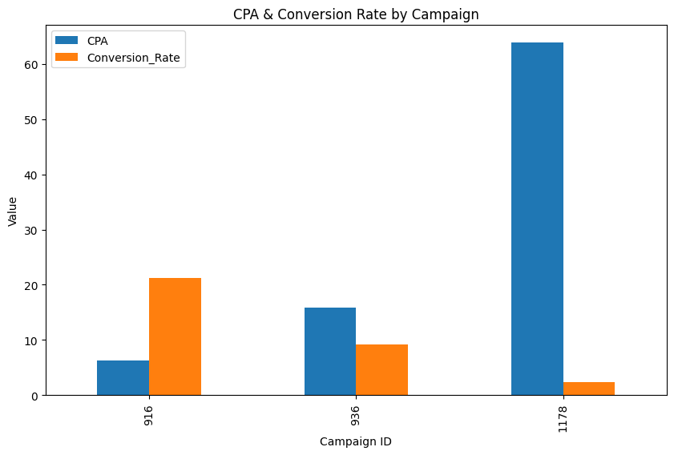
Campaign 1178 performed best in cost efficiency (CPA)
Campaign 916 had the highest Conversion Rate but lower CPA
Campaign 936 is balanced but weaker than others.

Slide 3
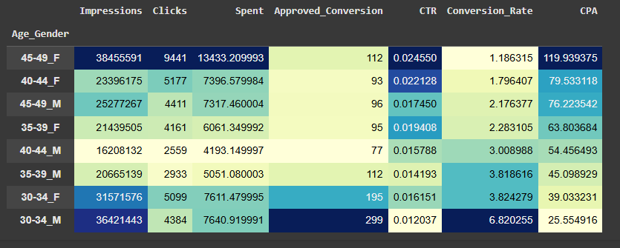
Best audience are 30–34 Males having highest conversions and lowest cost.
Good audience are 30–34 Females having strong performance and cost-effective.
Moderate audience are 35–39 age group.
Low priority for 45–49 Females having high CTR .
Focus most of your marketing budget on males and females of age 30s, because they give you the best results at the lowest cost.

Slide 4
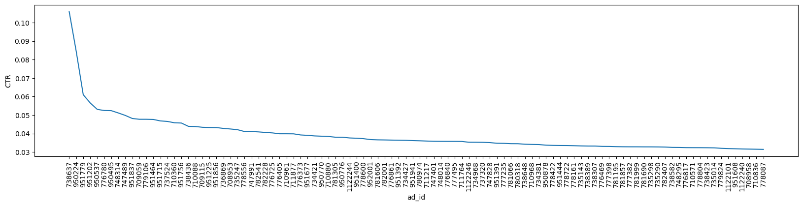
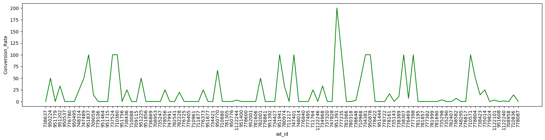
Top-performing ads are having high CTR and high conversions so focus more budget on them.
High CTR but low conversions ads are may need better landing pages.
Low CTR and low conversions ads are underperforming and should be paused.

Slide 5
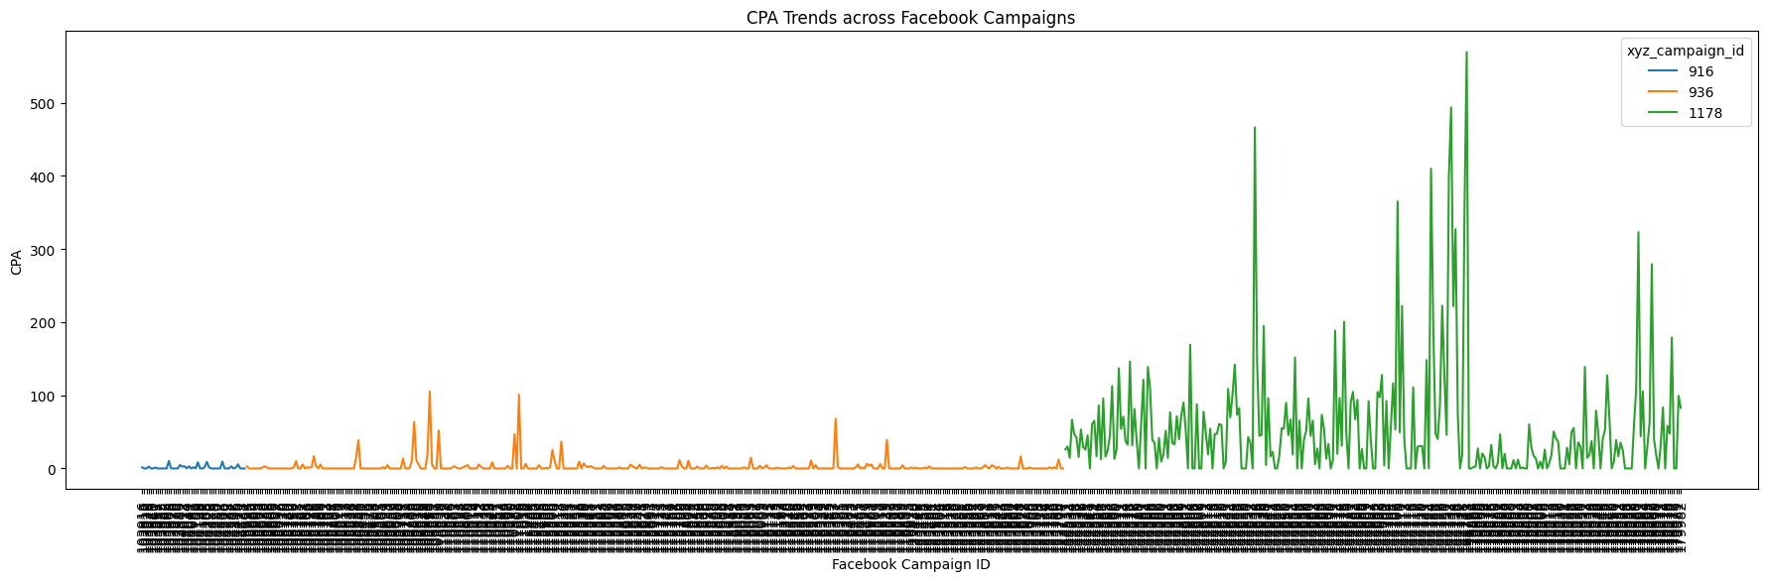
Campaign 916 is very stable, keeping costs per acquisition (CPA) consistently low across time.
Campaign 936 performs fairly well overall, but it has occasional cost spikes
Campaign 1178, while capable of generating high conversions.
This suggests that advertisers should focus spending on 916.

Slide 6
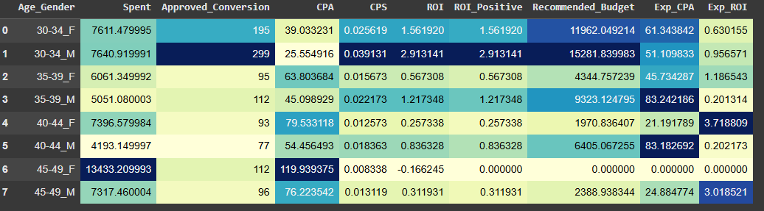
Females aged 30–34 are the strongest performing, generating the highest conversions and ROI, so they deserve a larger share of future budgets.
Males and females aged 35–39 also perform reasonably, so they can receive moderate investment. Older groups 45–49 show negative ROI, meaning money spent here is less effective and should be reduced.
To maximize ROI, more money should go to the younger high-performing segments.

Slide 7
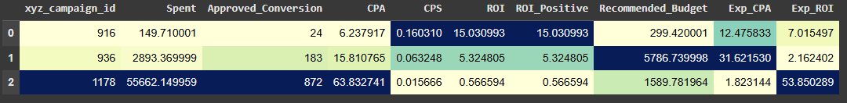
Campaign 916 gives the best ROI with low spend and strong conversion, so it should receive more budget in future.
Campaign 936 performs well, generating decent conversions at a sustainable CPA, so it can keep a healthy share of funding.
Campaign 1178 consumes the largest budget but delivers very poor ROI , future spending here should be reduced.
Future budgets should be shifted toward high-ROI campaigns 916 and 936, cutting down on low-return campaigns 1178.

Slide 8
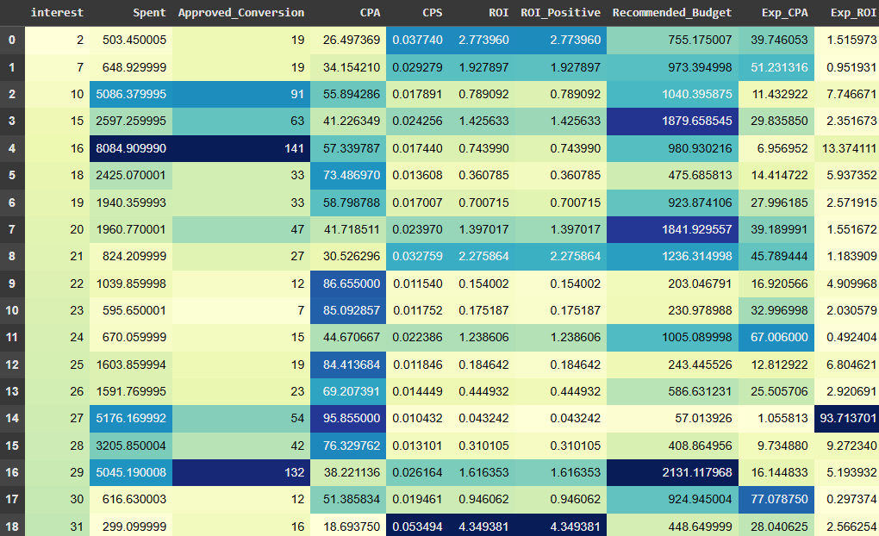

Slide 9
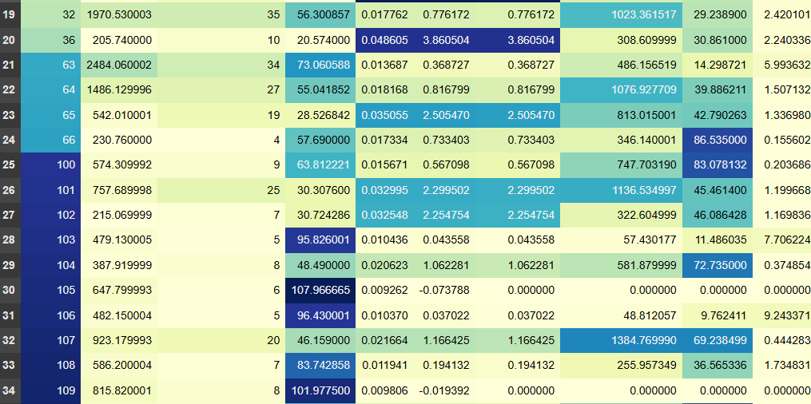
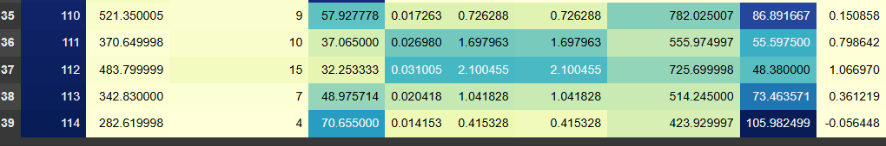
Segments interest 2, 7, 21, 31, and 36 deliver strong ROI with relatively low costs, making them the best for higher investment.
Segments interest 22, 23, 25, 26, 29, 104, and 109 show negative ROI, they consume budget without giving back enough value, so spending here should be reduced.
High-spend segments 16 and 29 generate a lot of conversions but have poor ROI, which suggests the strategy should be optimized rather than heavily funded.

Slide 10
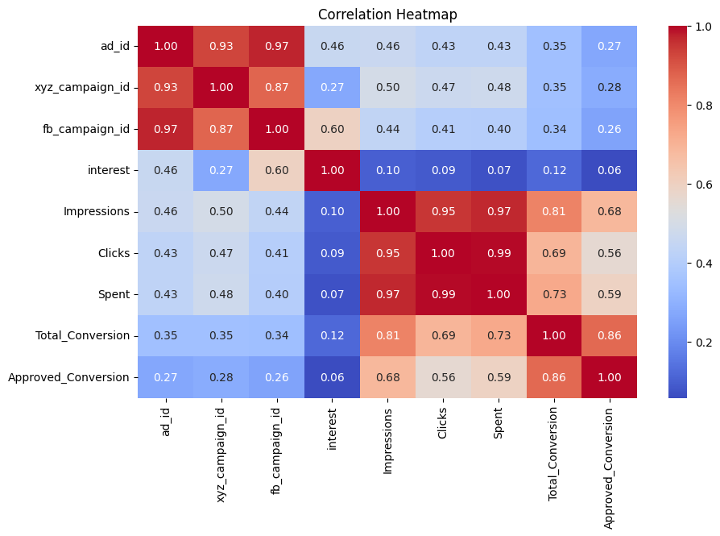
Impressions, Clicks, and Spent are very strongly correlated .
Interest has very weak correlation with conversions and spending.

Slide 11
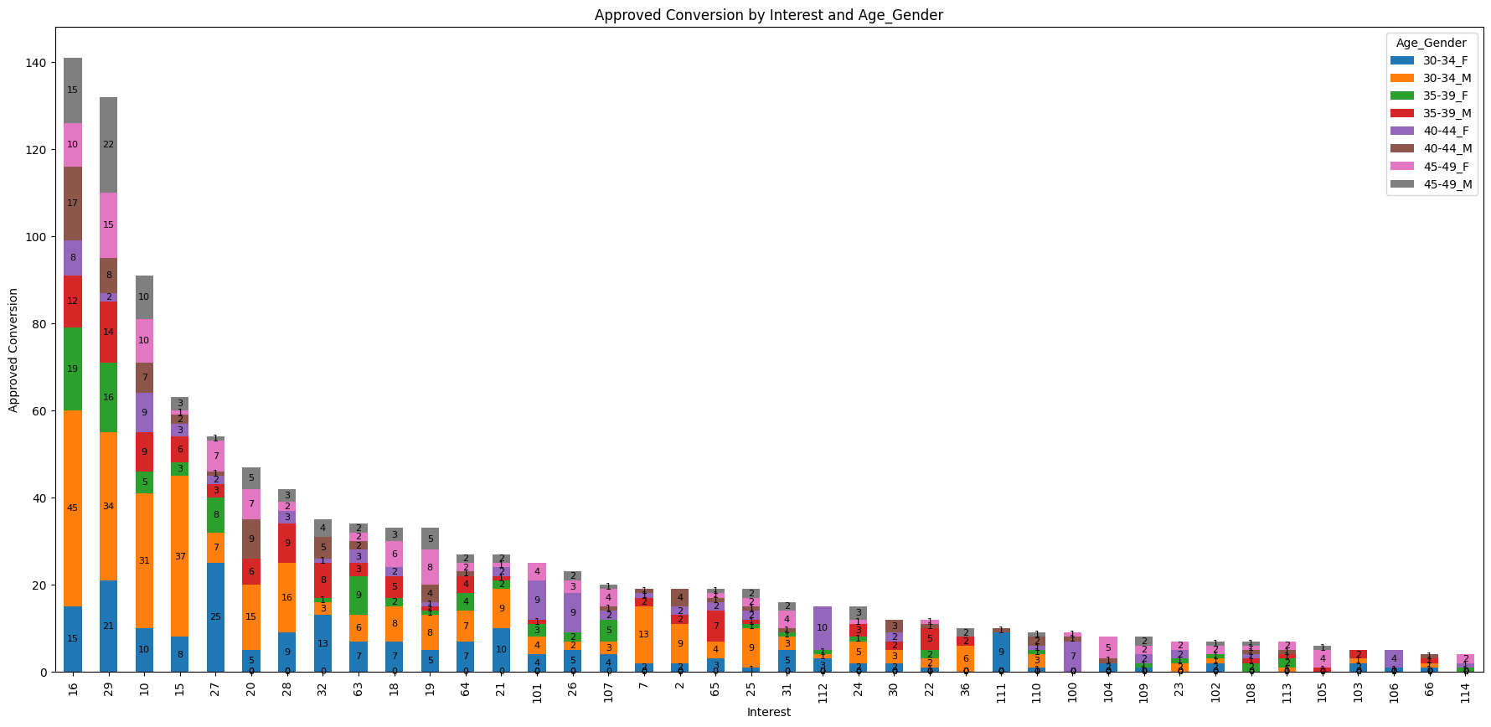
16, 29, 10, and 15 interest drive the highest conversions. Within these top interests, males aged 30–34 stand out as the largest contributors.
30–34 male segment is the biggest driver of results. To maximize outcomes, businesses should focus budget on the top interests where younger and mid-age groups perform best.

Slide 12
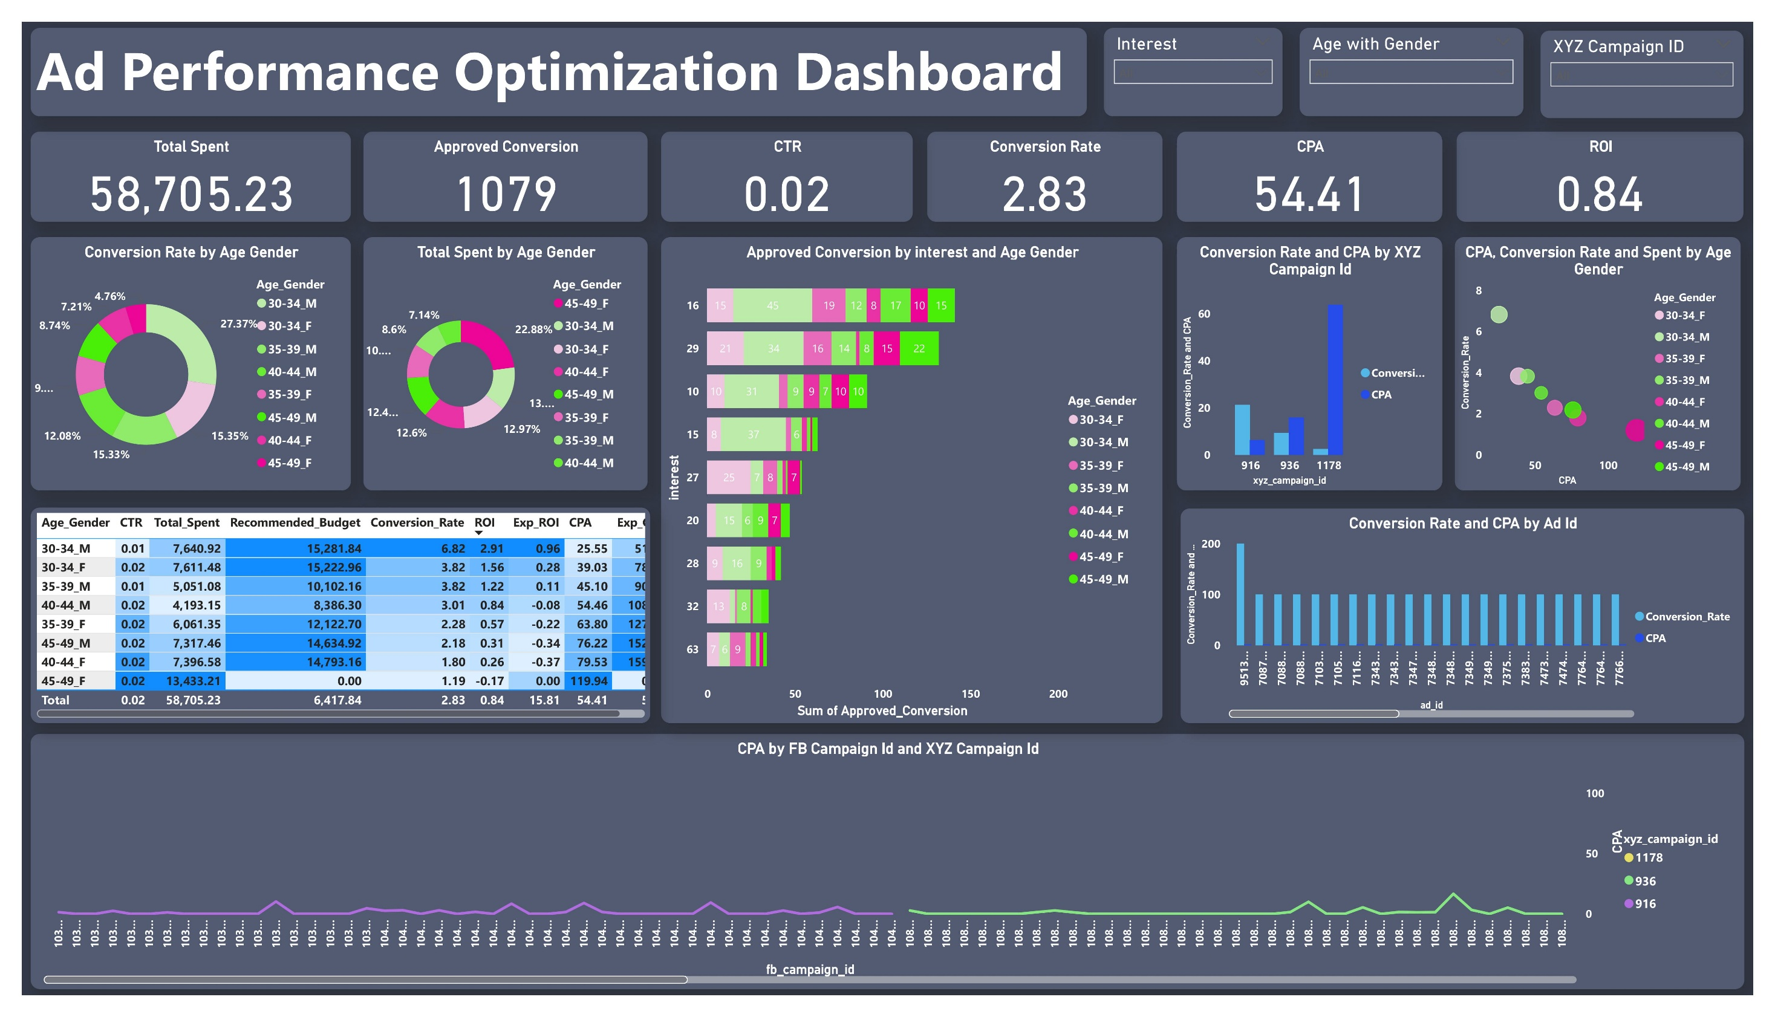

Slide 13
Final Recommendations
Audience Targeting
Focus budget on 30–34 Males and Females, as they deliver the highest conversions at the lowest CPA.
Provide moderate investment for the 35–39 age group, as they still perform reasonably well.
Reduce or stop spending on the 45–49 segment, especially females, since ROI is negative here.
Campaign Strategy
Campaign 916: Best ROI, stable low CPA, and strong conversions → prioritize and expand budget.
Campaign 936: Balanced performance with sustainable CPA → retain steady funding.
Campaign 1178: High spend but poor ROI → reduce budget significantly and only keep for reach if optimized.
Ad Creative & Optimization
Ads with high CTR + high conversions should receive maximum budget.
Ads with high CTR but low conversions need better landing pages or audience alignment.
Ads with low CTR and low conversions are underperforming → pause them.
Interest Segments
Strong ROI interests: 2, 7, 21, 31, 36 → increase spend.
Poor ROI interests: 22, 23, 25, 26, 29, 104, 109 → cut spending.
High-spend but weak ROI interests (16 & 29) → optimize targeting/creatives before reinvesting.
Future Optimization
Track time-series data (daily/weekly) for deeper seasonality insights.
Strong correlation exists between Impressions, Clicks, and Spend, but interest alone is weakly correlated with conversions → better audience refinement is needed.

Slide 14
Conclusion
The analysis shows that the most profitable strategy is reallocating budget toward 30–34 year-olds (both males and females), with campaigns 916 and 936 as the main drivers of ROI. Interest segments like 2, 7, 21, 31, and 36 should receive higher investment due to strong cost efficiency. By reducing low-ROI campaigns (1178) and underperforming segments (22, 23, 25, etc.), advertisers can maximize ROI while lowering costs. Future campaigns should improve creatives, optimize landing pages, and capture time-based data to refine performance further.
In short: Double down on 30–34 audiences + Campaigns 916 & 936, cut waste on 1178 and weak interests, and improve creative strategy for long-term growth.

